Slide 1
Concurrent Operation of Wireless Power Transfer Based Contactless Slip Ring and Motor Drive System with a Single Converter
Enes Ayaz
M.Sc. Thesis Defense
Middle East Technical University (METU), Department of Electrical and Electronics Engineering Ankara, TURKEY
September 2022
Notes:
Hello, dear committee and colleagues.
I am enes ayaz; today, I will defend my thesis entitled
“Concurrent operation of Wireless power transfer-based contactless slip ring and motor drive system with a single converter. “

Slide 2
Outline
Research Motivation
Operating Principles of Wireless Power Transfer Systems
Theory of the Proposed CSR System
Implementation of the Proposed Method with DC Motor Drives
Implementation of the Proposed Method with AC Motor Drives
Implementation of the Proposed Method for Field Excitation of SM
Conclusion
Notes:
Here is my outline.
Firstly, we will give the main motivations behind the study.
Secondly, we will talk about the basics of a wireless power transfer system.
Then, we will discuss the theory of the proposed system.
After that, the following three parts are related to implementing the proposed system in different motor drives, and I will demonstrate experimental validation.
Finally, we will examine the literature, give our system's main contribution, and show possible future works.

Slide 3
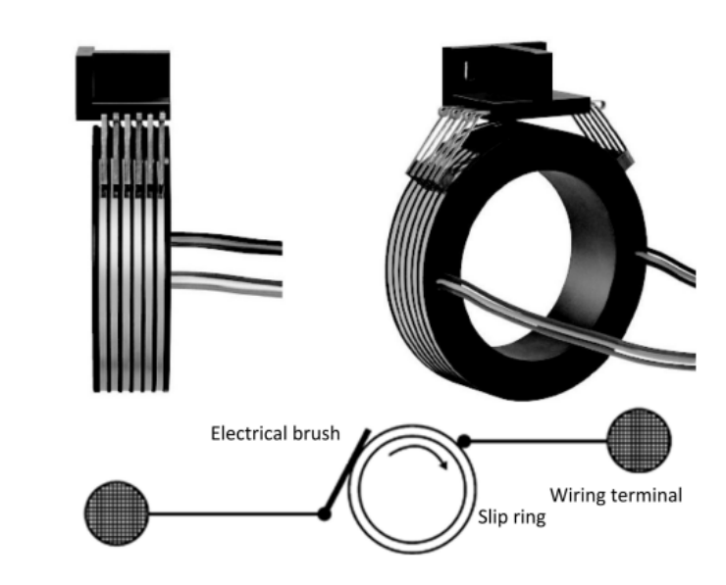
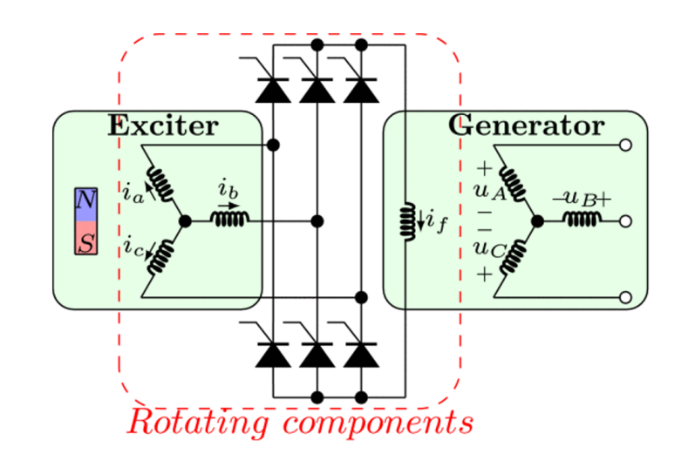
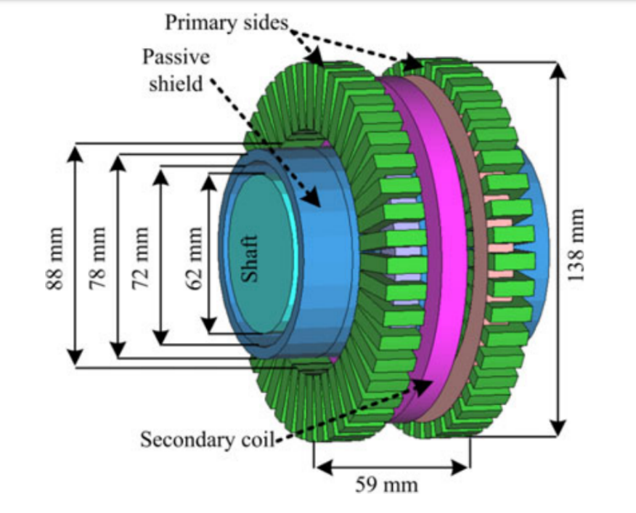
Power Transfer to Rotating Frames
Slip Rings
Brushless Exciters
Contactless
Slip Rings
Notes:
Okay, here we go,
Power transfer to rotating frames is required in many industrial applications such as rotating sensors, spindle motors, radars, and field excitation of motors.
There are several methods to achieve this power transfer.
The first one is slip rings or as known as mechanical slip rings.
They are made up of conductor rings, and carbon brushes rubbed with these rings.
The second one is Brushless exciters, actually a PM synchronous generator with rectified output.
The third one is contactless slip rings based on Wireless power transfer. It can be counted as an air-core contactless transformer.

Slide 4
Comparison of the Conventional Solutions
 | Slip Rings | Brushless Exciters | Contactless Slip Rings
Reliability | - | + | +
Maintenance | - | + | +
Simplicity | + | + | -
Speed Independency | + | - | +
Cost Effectivity | + | + | -
Efficiency | + | - | +
Notes:
Each of these solutions has some advantages and disadvantages.
Slip rings are simple, cost-effective, and efficient.
However, they are unreliable and require regular maintenance due to the physical wear of continuous friction.
Brushless exciters are reliable, but their power transfer capability changes with the rotation speed.
Since it is a generator, increasing speed also increases the voltage.
Therefore, it is only suitable to use in constant speed operation.
Contactless slip rings are both reliable and give speed-independent output voltage.
However, they are complex and costly since it requires active converters.

Slide 5
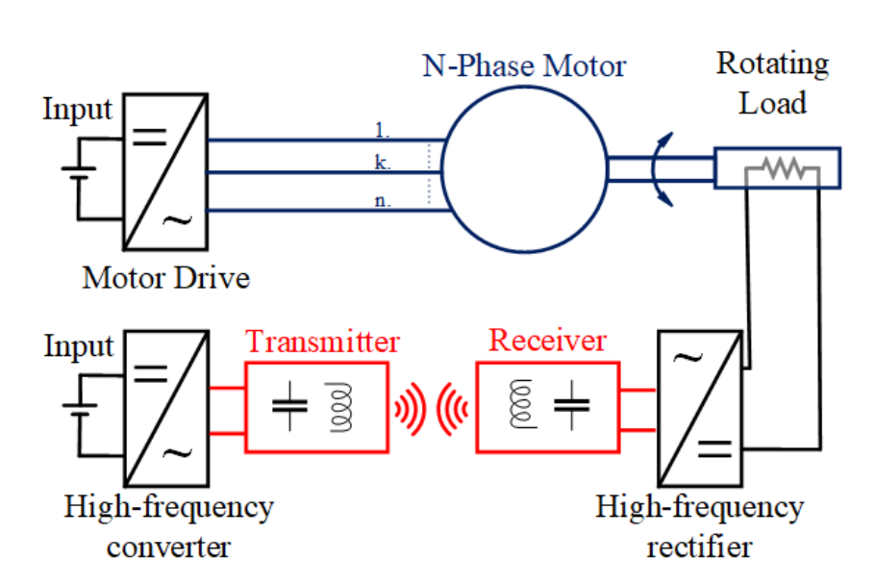
Conventional Inductive Power Transfer Based Contactless Slip Ring
Two converters:
To drive the motor
To excite the Tx coil
Motor → attenuated in motor current
The motor drive → generating low and high frequencies
Motor → used to drive
The WPT converter → generating high frequency
The WPT system →behaves like band-pass filter
Notes:
Our focus is on contactless slip rings.
Here, we have a representation of conventional contactless slip rings.
The common trait of these contactless slip rings; we have a motor drive system to achieve rotating load.
Inductive power transfer systems, a type of WPT system, are commonly used in such systems since they give a moderate transfer distance and higher efficiency.
IPT systems have four main parts: High-frequency converter, Transmitter, receiver, and high-frequency rectifier.
So, conventional contactless slip rings have two converters.
One of both is the converter of the motor drive.
Another is the high-frequency converter of the WPT system.
The motor drive also generates high-frequency switching components at the output, but the motor filters these components out.
A low-frequency modulating signal is used to drive the motor.
WPT converter generates high-frequency square waves, and Tx and Rx generally have band-pass filter characteristics.
Therefore, it only allows the desired high-frequency components to pass through.
Consequently, we have two converters in this system, which increase cost and complexity and decrease reliability.

Slide 6
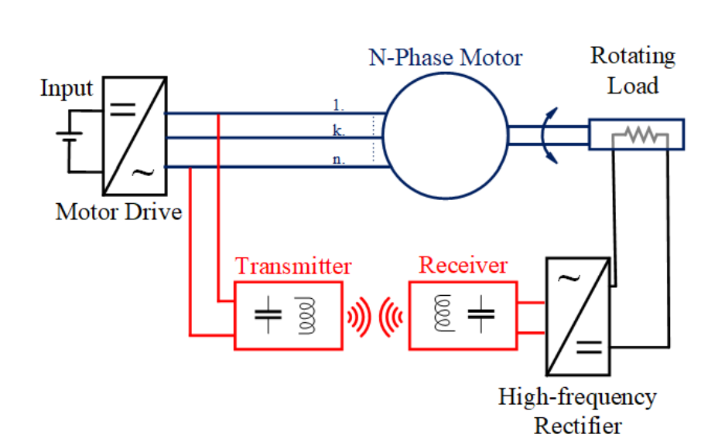
Proposed Inductive Power Transfer Based Contactless Slip Ring
The motor drive → generating high frequency
combining
The WPT system →behaves like band-pass filter
No longer required
The WPT converter → generating high frequency
Notes:
In the proposed system, the WPT system is excited by the motor drive’s high-frequency switching components.
Since the WPT system behaves like a band-pass filter, we do not observe the low-frequency modulating current.
Therefore, a separate WPT converter is no longer required.

Slide 7
Comparison of the Conventional and Proposed Contactless Slip Rings
 | Conventional Contactless Slip Ring | Proposed Contactless Slip Rings
Reliability | + | +*
Maintenance | + | +*
Simplicity | - | +
Speed Independency | + | +
Cost Effectivity | - | +
Efficiency | + | +
+* : a slightly advantageous
Notes:
In order to show our main advantages, we made a comparison table.
We increase the system reliability by eliminating the extra converter and decreasing the maintenance requirements.
Further, the system is simple and cost-effective due to the reduced active components.

Slide 8
Outline
Research Motivation
Operating Principles of Wireless Power Transfer Systems
Theory of the Proposed CSR System
Implementation of the Proposed Method with DC Motor Drives
Implementation of the Proposed Method with AC Motor Drives
Implementation of the Proposed Method for Field Excitation of SM
Conclusion
Notes:
I showed our motivations, aims, and outcomes in the previous part.
Here, we will examine the basics of wireless power transfer systems.

Slide 9
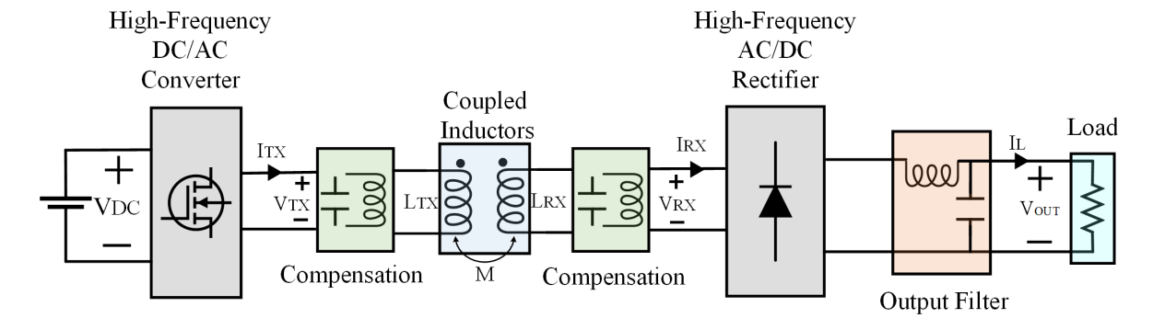
Inductive Power Transfer System
Notes:
This figure shows a block diagram of a conventional IPT system.
We have a high-frequency converter that generates a square wave voltage/current waveform.
Without compensation, the coupled inductors have a large leakage inductance, which inherently causes a low power factor.
We can use series or parallel capacitors to compensate for the leakage inductance.
The capacitors and coupled inductance create a resonant structure. Then, only the fundamental sinusoidal signal passes through the coupled coils.
The transmitted sinusoidal wave is rectified, and a ripple within DC exists.
The output capacitance and inductance filter out the ripple, and we achieve a DC output.

Slide 10
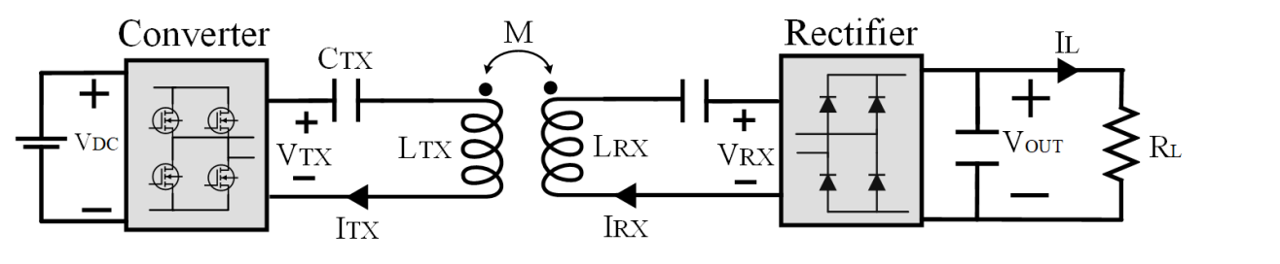
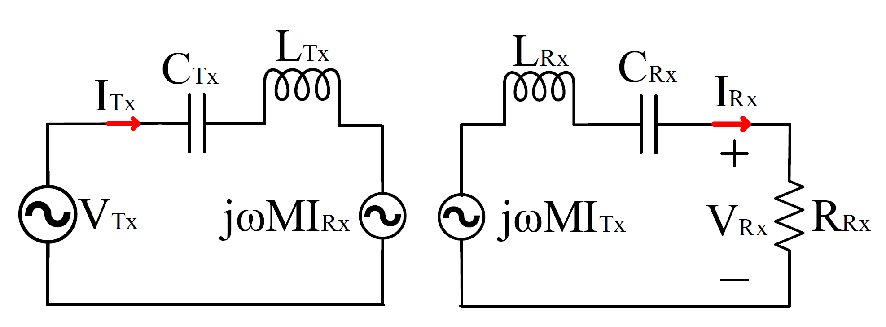
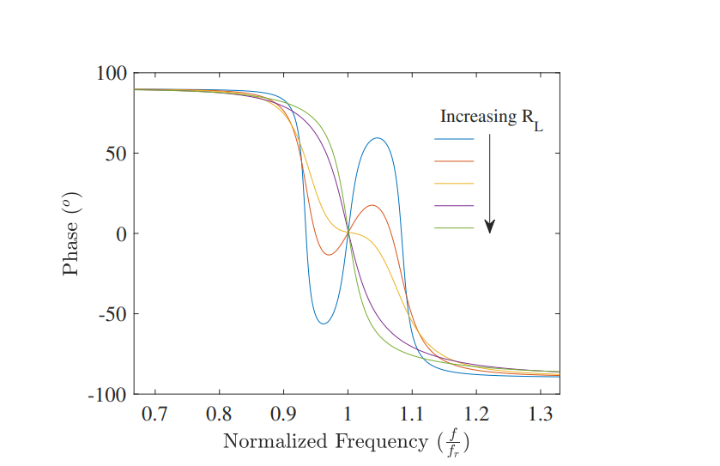
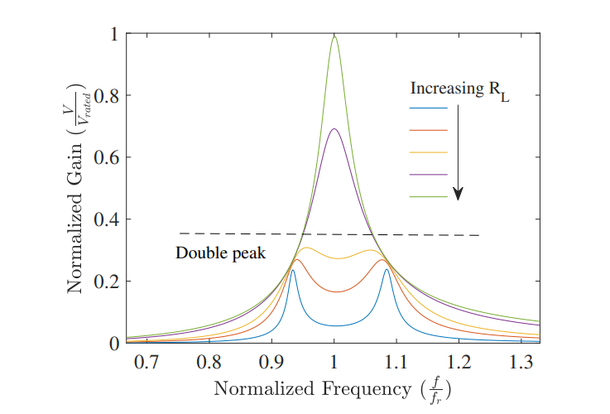
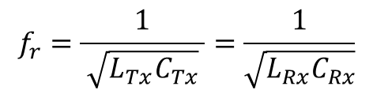
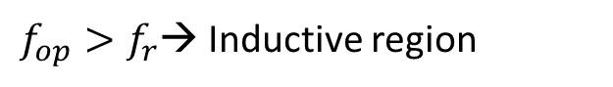
Series-Series IPT System
CRX
Single-peak band pass filter
First Harmonic Approach (FHA)
Phase < 0 → Inductive region
$f_{op}>f_{r}$→ Inductive region
$$f_{r}=\frac{1}{ \sqrt{L_{Tx}C_{Tx}} }=\frac{1}{\sqrt{L_{Rx}C_{Rx}}}$$
Notes:
In this study, we use a series/series compensation is preferred.
We discussed it all in detail in the thesis.
Before, we said that the IPT system behaves like a band-pass filter, and only a fundamental signal is transmitted.
Therefore, a frequency domain circuit diagram can be used to model the IPT, called the first harmonic approach.
In conventional IPT systems, there are two operating regions, which are inductive and capacitive.
Band-pass characteristics change considering the load.
Firstly, we investigate single peak band-pass filter characteristics, shown with a green line.
The system operates in the inductive region if the operating frequency is greater than the resonant frequency.
The resonant frequency can be calculated as given. It is significant for conventional systems to achieve ZVS.
However, double-peak characteristics occur if the load resistance is lower, called bifurcation phenomena.
Bifurcation-free system is preferred to achieve ZVS by adjusting only the frequency greater than the resonant frequency.

Slide 11
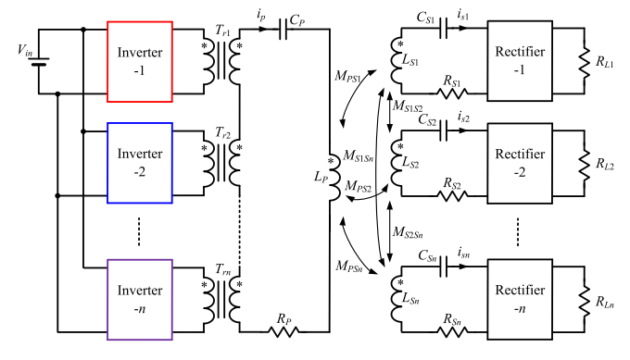
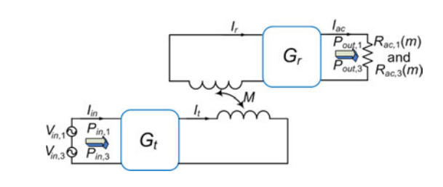
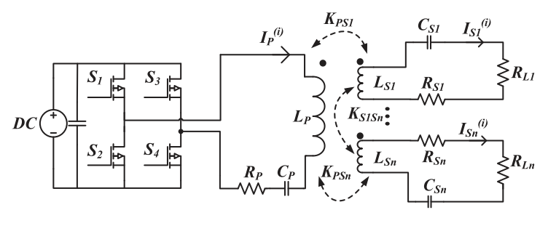
Multifrequency IPT Systems
Motivations:
To Increase power
To reduce switching components
To increase DC-link utilization rate
To provide operation for more than one standards
Some Topologies:
Multi-converter and multi-resonant
Single-converter and multi-resonant
Single-converter and multi-load
Notes:
We talked about conventional systems.
In conventional IPT systems, the converter generates a square wave having multiple frequencies, and only the fundamental is transmitted via the resonant structure.
In literature, multifrequency IPT systems are also utilized.
The motivations for multifrequency can be listed as given.
For example, the third harmonic of the square wave is utilized via a multi-resonant structure and single converter.
Or, the system can be desired to operate more than frequency; multi-converter and multi-resonant can be utilized.
In my thesis, the WPT system is excited by motor drive.
It can be considered as a single-converter and multi-load system; the motivation is to reduce the switching components.
However, motor driving should be dynamic and requires a fast response.
Then, we should use conventional motor driving modulations.
In this condition, the main problem reveals.
How to control dual-frequency by conventional motor driving modulation.

Slide 12
Outline
Research Motivation
Operating Principles of Wireless Power Transfer Systems
Theory of the Proposed CSR System
Implementation of the Proposed Method with DC Motor Drives
Implementation of the Proposed Method with AC Motor Drives
Implementation of the Proposed Method for Field Excitation of SM
Conclusion
Notes:
We will continue with the theory of the proposed system.

Slide 13
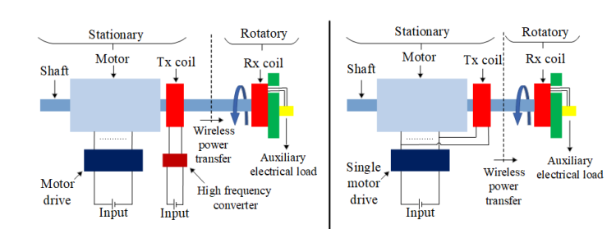
The Proposed Contactless Slip Ring Method
Conventional System
Proposed System
Motor Drives
DC motor drives
AC motor drives
Notes:
The conventional and proposed systems are presented in this figure.
The system is mounted to the shaft, and the Rx coil rotates with the shaft.
We eliminate the WPT converter; AC or DC motors and drives can be used in the proposed system.

Slide 14
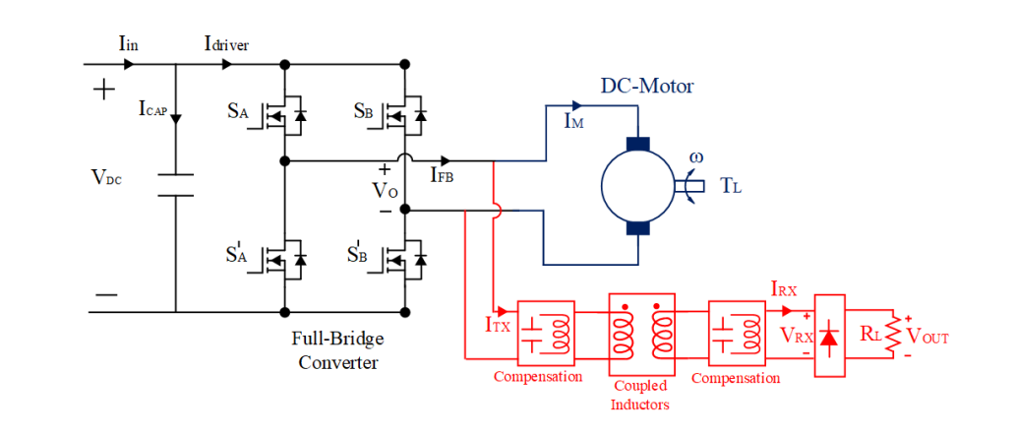
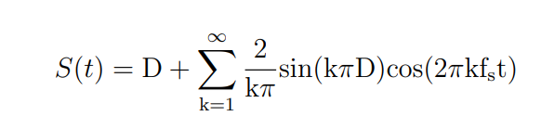
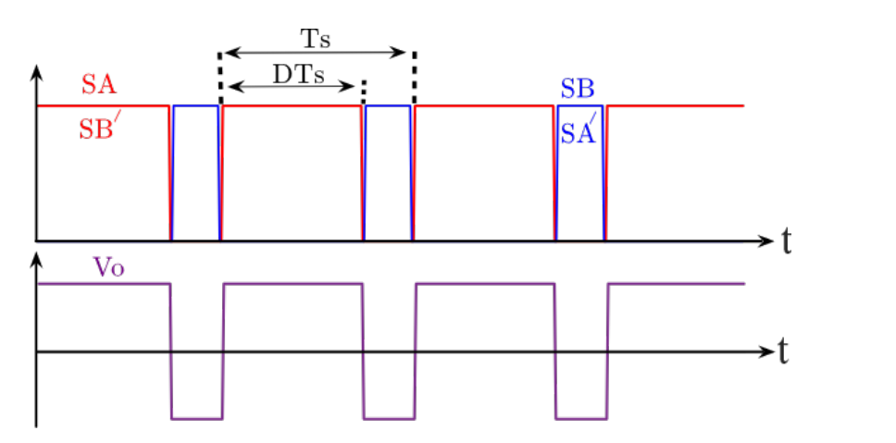
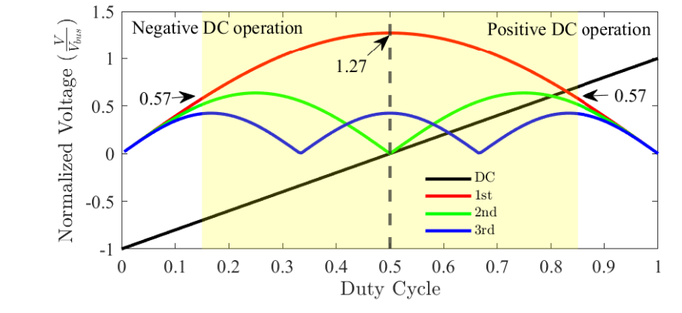

Modulation Technique for DC Motor Drives
$$S_{A}=S_{B}^{′}$$
Notes:
Let me start with DC motor drives.
In DC motor drives, we use a voltage source full-bridge converter, which is commonly used since it provides four-quadrant operation.
Since it is a voltage source converter, we can connect the WPT system in parallel, as shown in this figure.
Bi-polar PWM schemes are proffered as a PWM method, where SA and SB’ have the same signals.
The PWM signals are shown here; we change the DC voltage at the output by varying duty cycles.
According to the duty cycle, the DC and switching harmonics are shown here.
The duty cycle is changed to adjust the DC voltage; however, switching harmonics also vary.
However, we want to use these harmonics in the WPT system; therefore, the variation is compensated.
Further, we should limit our duty cycles since the switching harmonics approach 0 near the duty cycle is 0 or 1.

Slide 15
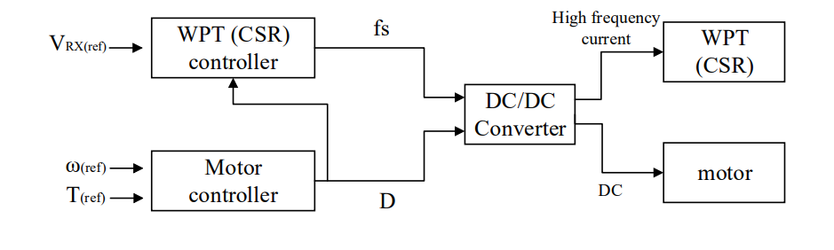
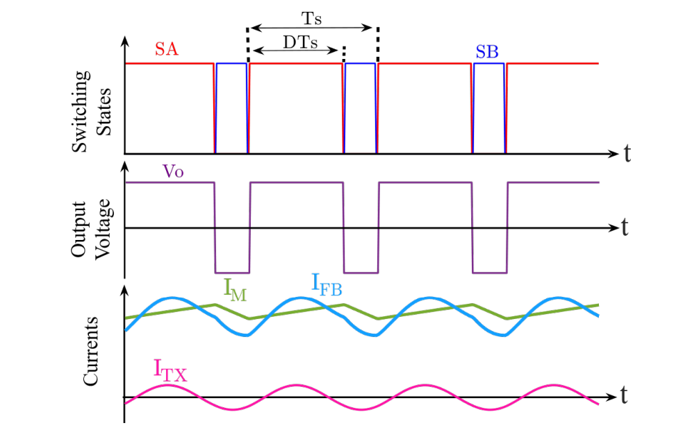
Proposed Control Method
Notes:
In the previous slide, we said that the switching harmonics vary with the duty cycle.
We introduce an independent control parameter, switching frequency, to control WPT power and keep it constant under any modulation.
The gain characteristics of the WPT system are shown; we can change the gain of the WPT system by switching frequency.
Switching frequency does not affect the motor operation since the motor time constant is large.
By applying appropriate frequency, we keep the WPT power independent of the duty cycle.
The switching signals, output voltage, and current waveforms are shown here.
The WPT system has lower ratings than the motor, and the current is much smaller than the motor current.
Therefore, the converter current does not look completely different from the motor current.

Slide 16
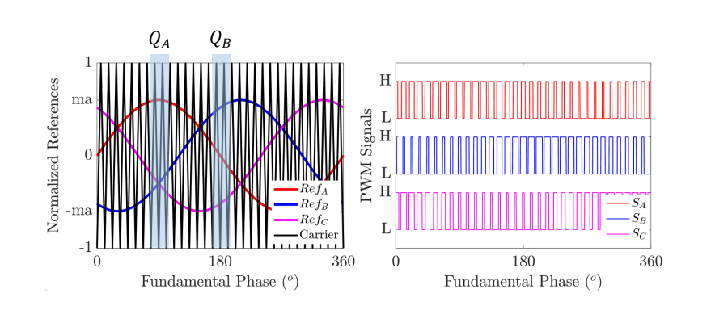
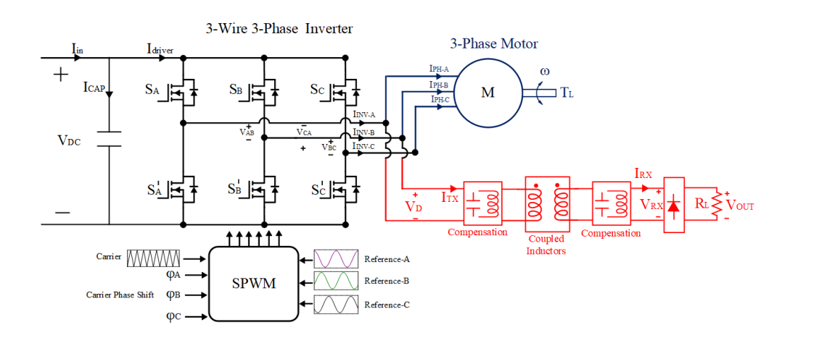
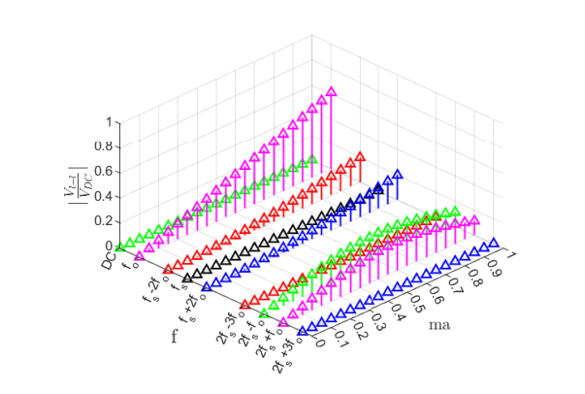
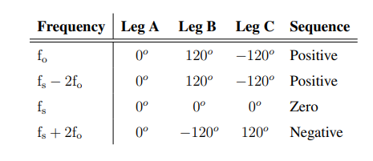
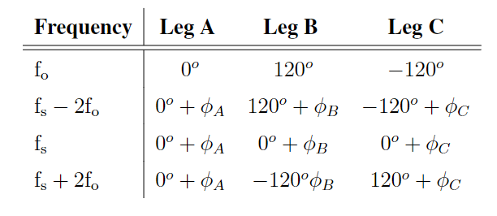
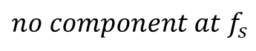
Conventional Modulation Technique
$$no component at f_{s}$$
Notes:
In AC motor drives, we use a 3-wire 3-phase voltage source inverter.
SPWM is applied to generate a required voltage waveform at the inverter output.
We have sinusoidal reference signals that are compared with triangular carrier signals, creating PWMs.
In standard SPWM, line-to-line voltage harmonic distribution is shown.
There is no component at the switching frequency since the switching frequency, and sidebands create zero/positive/ negative sequences.
In this condition, we can not control the switching harmonic, so the WPTs power.
In the proposed system, we can give a phase shift to the carrier signals to eliminate the zero sequences.

Slide 17
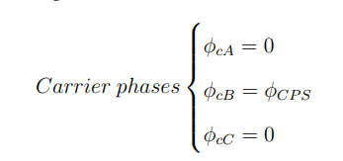
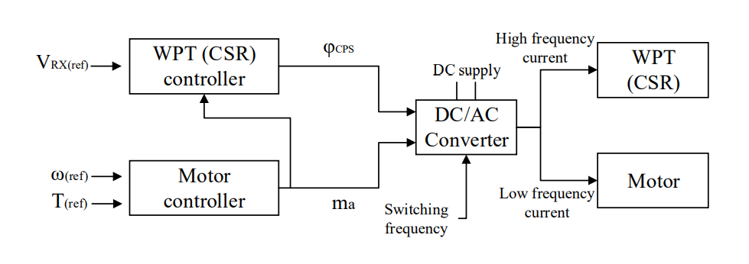
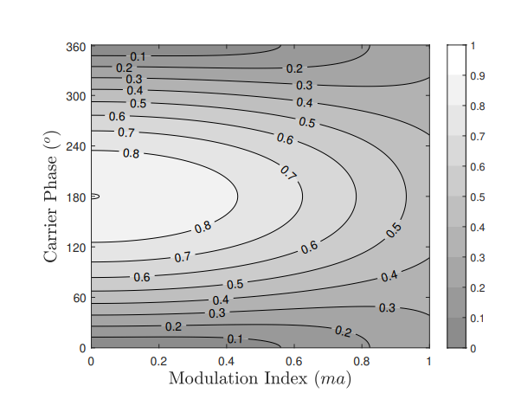
Proposed Control Method
Notes:
The WPT system is connected between phase-A and phase B.
By carrier phase shift to phase B, we achieve this contour of the magnitude of the switching frequency.
We can observe that we can have a constant gain for any modulation.
The constant gain is between 0.25 and 0.45 over a DC-link voltage.
The control diagram is shown.
We adjust the carrier phase shift according to modulation to control the WPT power.

Slide 18
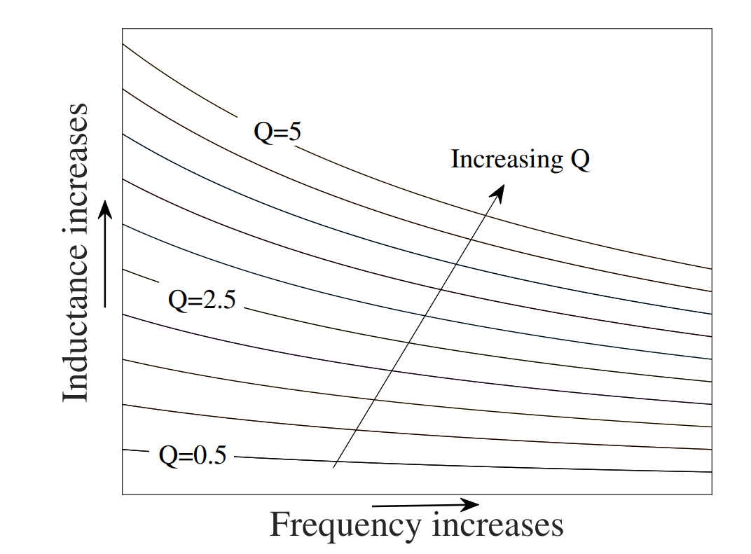
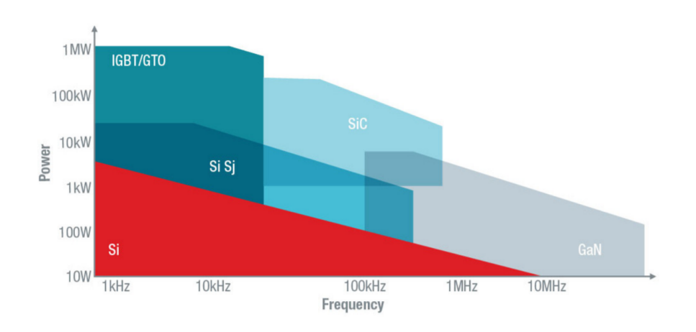
Practical Considerations
require higher switching frequency
WPT systems
to achieve smaller coil sizes
require relatively lower switching frequency
Motor
drives
to reduce
switching losses
Both requirements are provided conventional GaN or SiC based motor drives
Notes:
Until here, we discussed the concurrent operation of the WPT and motor for DC and AC motor drives.
However, there are some practical considerations. The operating frequency of WPT should be higher to achieve a smaller WPT coil size.
However, conventional Si-based motor drives have a lower switching frequency below 20 kHz due to the switching losses.
In this range, the WPT system is not feasible.
However, with the development of wideband-gap devices, the switching frequency increases up to 100 kHz.
Therefore, the proposed system is suitable for motor drives based on SiC and GaN semiconductors.

Slide 19
Outline
Research Motivation
Operating Principles of Wireless Power Transfer Systems
Theory of the Proposed CSR System
Implementation of the Proposed Method with DC Motor Drives
Implementation of the Proposed Method with AC Motor Drives
Implementation of the Proposed Method for Field Excitation of SM
Conclusion
Notes:
We showed the theory of operation of the proposed system.
We will continue with the implementation of the proposed system to conventional drives.
Firstly, we start with DC motor drives.

Slide 20
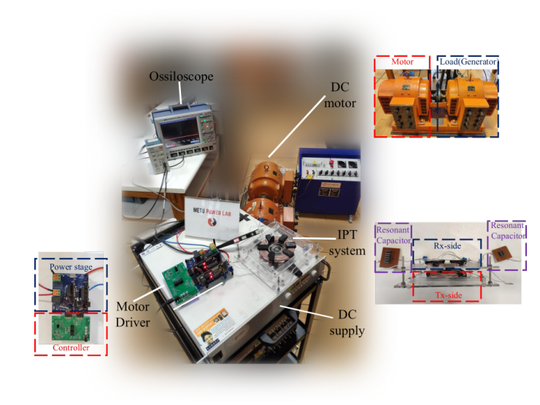
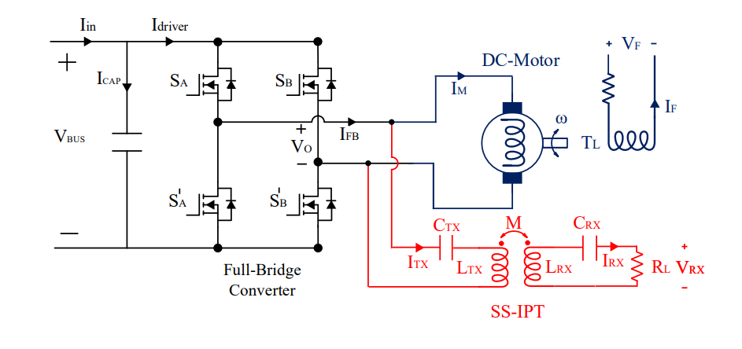
System Overview and Experimental Setup
Notes:
We have a full-bridge converter and a separately excited DC motor.
The SS-IPT system is connected in parallel to the motor drive.
The experimental setup is shown in the figure.

Slide 21
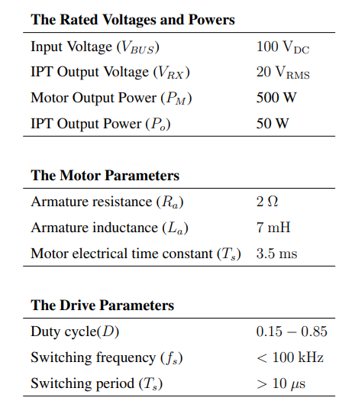
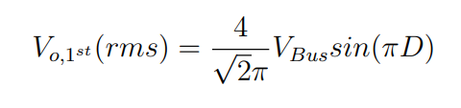
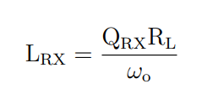
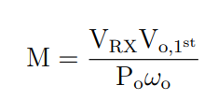
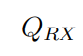
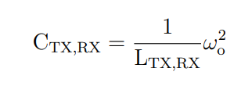
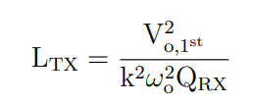
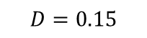


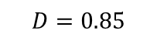
Wireless Power Transfer System Design Procedure
$$0.15 < D< 0.85$$
$40 V_{RMS}$< $V_{o,1^{st}}(rms)$< $90 V_{RMS}$
$$D=0.15$$
$$D=0.5$$
$$D=0.85$$
$$k$$
Notes:
The system ratings are presented here.
Before the design stage of the WPT system, the DC-link voltage and duty cycle limits are important.
The duty cycle is limited between 0.15 and 0.85, which means that the minimum voltage at the switching frequency is 40V.
The maximum voltage is reached at D=0.5, which gives 90V.
Therefore, the WPT system should give the desired power for these input variations, which is compensated by frequency control.
Coupling and quality factors are design parameters, and we can calculate the parameters as given.

Slide 22
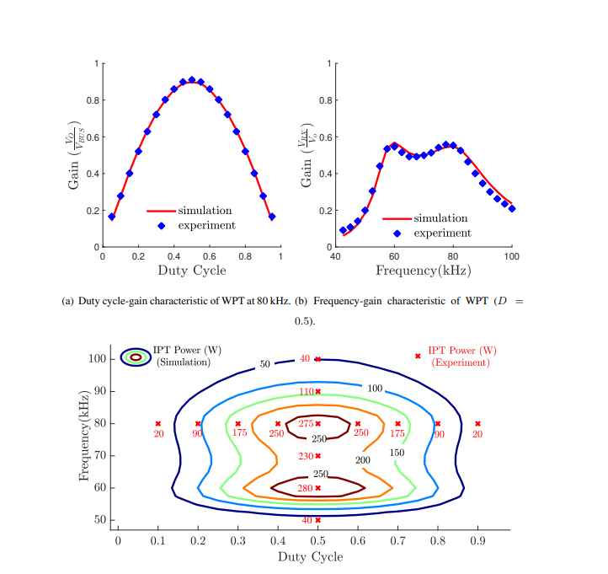
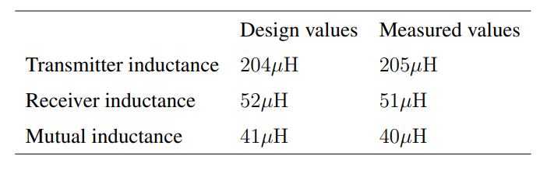
Experimental Results- WPT System Validation
Notes:
The design and measured values are presented here.
The WPT system is tested for different duty cycles and switching frequencies.
The contour of the output power over the duty cycle and switching frequency is plotted.
We can observe iso-power lines. We choose the outer iso-power line, which can supply the desired power under any given duty cycle.

Slide 23
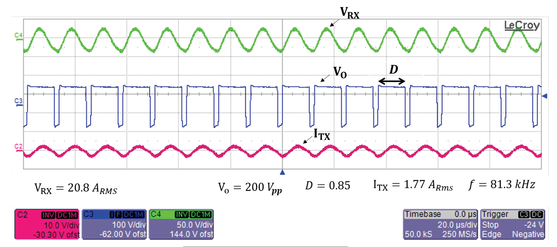
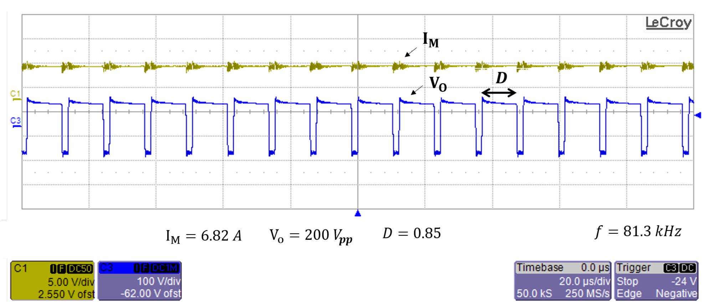
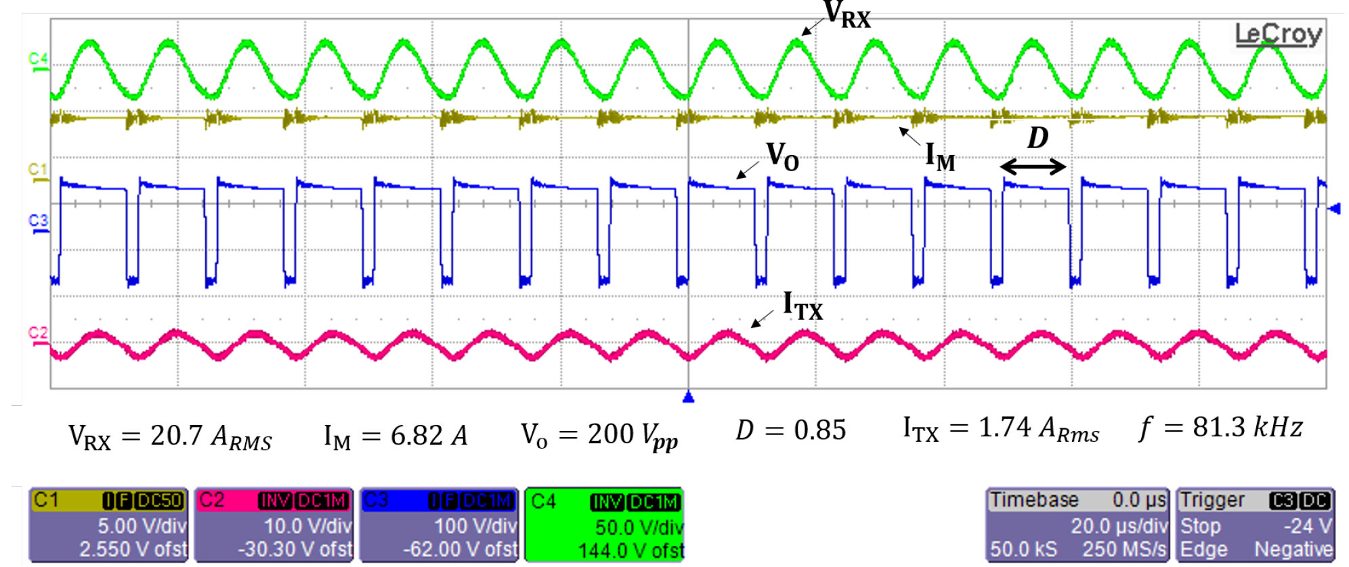
Experimental Results - Concurrent Operation
Notes:
In order to validate the concurrent operation.
Firstly, only the WPT system is connected. The switching frequency is 81.3 kHz, the duty cycle is 0.85, and its output voltage is 20.8V.
Then, only the motor is connected to the motor drive for the same duty cycle and switching frequency.
The motor drive delivers 480W. After, the WPT and motor are connected together.
It is observed that the motor and WPT supply the power as the stand-alone connection.
Therefore, we can say that the concurrent operation can be done by applying the appropriate duty cycle and switching frequency.
In the thesis, the concurrent operation is tested under several duty cycles and switching frequencies to observe the continuous power transfer.

Slide 24
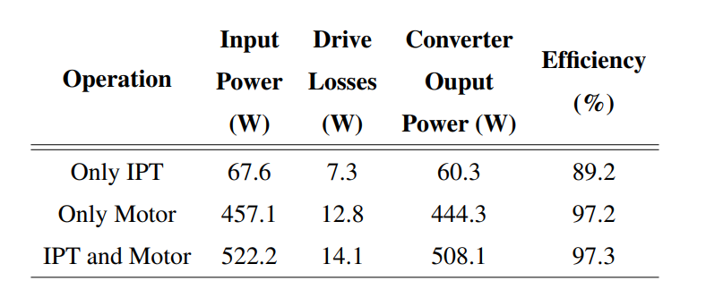
Experimental Results – Loss and Efficiency
Notes:
Okay, we achieve concurrent operation, but it can increase the losses, and the system cannot be faced with thermal stress.
The drive losses are measured via a calorimeter setup.
The drive losses of concurrent operation increase only 10% compared to the only motor operation.
The sum of only IPT and only motor losses is much higher than the concurrent operation.
Since the IPT current is much less than the motor current, there is a small increment on the only motor operation.

Slide 25

Experimental Results – Transient Load Changes
Notes:
Another test is about transient load changes.
The motor and WPT have varying load conditions.
Although the duty cycle and frequency do not change, the load change can affect each other operations.
The transient load changes do not affect the steady-state operation of the motor and WPT system.
However, it was observed that the motor is affected transitory where the current slightly changes ( by a 5% overshoot or undershoot ).
Then, it reaches the expected steady-state value in a short time as expected.
These tests prove the independent and concurrent operation of the motor and WPT system.

Slide 26
Outline
Research Motivation
Operating Principles of Wireless Power Transfer Systems
Theory of the Proposed CSR System
Implementation of the Proposed Method with DC Motor Drives
Implementation of the Proposed Method with AC Motor Drives
Implementation of the Proposed Method for Field Excitation of SM
Conclusion
Notes:
We presented the implementation with DC motor drives.
Now, we will continue with AC motor drives.

Slide 27



System Overview and Experimental Setup
Notes:
We have a 3-phase 3- wire inverter and induction machine.
The SS-IPT system is connected to two legs of the inverter in parallel to the motor.
The experimental setup is shown in the figure.
The system ratings are also given.
As discussed before, the gain can be constant by carrier phase shift.
Therefore, the carrier phase shift is adjusted between 30 and 60 degrees to achieve a 0.3 gain.

Slide 28


Experimental Results- Carrier Phase Shift Validation
Notes:
Firstly, the SPWM and carrier-phase shift is validated.
With and without CPS, the inverter output voltage at the fundamental switching and its sidebands are mathematically calculated.
After that, the output voltage is measured, and the harmonic distribution is in good agreement with the theoretical calculation.

Slide 29

Experimental Results - Concurrent Operation
Notes:
In order to validate the concurrent operation.
Firstly, only the motor is connected.
Modulation is 0.8, and the carrier phase shift is 40 degrees.
The motor draws 1.75 A.
Then, the WPT is connected to the motor drive for the same modulation and carrier phase shift.
It draws 0.35 A.
After, the WPT and motor are connected together.
It is observed that the motor and WPT supply the currents the same as a stand-alone connection.
Therefore, we can say that the concurrent operation can be done by applying appropriate modulation and carrier phase shift.

Slide 30


Experimental Results – Variable Carrier Phase Shift
Notes:
Other tests are made to find the required carrier phase shifts to achieve constant power.
A lookup table is obtained in the experimental setup, and the carrier phase shift values are compared with the theoretical ones.
They are in good agreement. Besides, as seen in the figure, the power is kept constant with appropriate carrier phase shift.

Slide 31


Experimental Results – Transient Load Changes
Notes:
Another test is about transient load changes.
The motor and WPT have varying load conditions.
Although modulation index and carrier phase shift do not change, the load change can affect each other operations.
The transient load changes do not affect the steady-state operation of the motor and WPT system.
These tests prove the independent and concurrent operation of the motor and WPT system.

Slide 32
Outline
Research Motivation
Operating Principles of Wireless Power Transfer Systems
Theory of the Proposed CSR System
Implementation of the Proposed Method with DC Motor Drives
Implementation of the Proposed Method with AC Motor Drives
Implementation of the Proposed Method for Field Excitation of SM
Conclusion
Notes:
We presented the implementation with AC motor drives.
Now, we will continue with a special application field excitation of synchronous machine.

Slide 33



System Overview and Experimental Setup
Notes:
We have a 3-phase 3- wire inverter and synchronous machine.
Here, we use an SN-IPT system connected to two legs of the inverter in parallel to the motor.
The experimental setup is shown in the figure.
The system ratings are also given.
As discussed before, the gain can be constant by carrier phase shift.
In order to decrease the Tx current, we choose the maximum controllable voltage gain over every modulation index is selected. It is 0.40.
The design of the SN IPT system and explained in detail in the thesis; we pass the experimental results directly.

Slide 34


Experimental Validation- Carrier Phase Shift
Notes:
The field of the synchronous is fed by the WPT system.
We have three operation conditions of different modulation indexes.
The proposed carrier phase shift guarantees the mean value of the field current is brought to the desired value.
However, increasing the modulation index causes a low-frequency fluctuation, double the fundamental frequency.
The current fluctuations are presented in this figure.
The fluctuation is stemmed from the sideband harmonics, which change the effective voltage magnitude at the switching frequency component.
The fluctuation should be mitigated since it can cause a torque and speed ripple for the synchronous machine.

Slide 35



New real-time algorithm
Notes:
So, a new idea is revealed here.
Real-time control of the switching frequency to keep the magnitude constant.
The switching component magnitudes change over a fundamental frequency in each operation point.
Therefore, we can calculate the carrier phase shift value for each switching interval before applying the PWMs.
And we achieve a constant magnitude at the WPT system.
The carrier phase shift can be calculated by Fourier series and phasor domain sum, as seen in these equations.

Slide 36






New real-time algorithm
$$V_{D}=30 V_{RMS}$$
${\hat{S}}_{AB_{fs}}=0.43 !$
$m_{a}<0.85$
Notes:
However, in these conditions, also we have some restrictions.
Since the duty cycle at any time is dependent the motor modulation, so SPWM, We cannot achieve some voltages.
These figures draw the maximum and minimum voltage gains for several modulation indexes.
Maximum voltages actually correspond to 180-degree carrier phase shift, while minimum voltage corresponds to 0 degrees.
As can be observed graphically, we can achieve a 0.43 gain over a fundamental frequency for every modulation index below 0.85.
To avoid low-frequency fluctuation, we can restrict our modulation index.

Slide 37


Experimental Validation- Carrier Phase Shift
Notes:
After that, we repeat the same experiment with the previous ones.
The field current, however, is a little bit different due to the voltage restriction.
It gives 30 V RMS, while we used 45 V RMS before.
The low-frequency fluctuations still exist, but the magnitude is considerably reduced.
It is almost in a quart of the previous test for modulation index is 0.5.

Slide 38
Outline
Research Motivation
Operating Principles of Wireless Power Transfer Systems
Theory of the Proposed CSR System
Implementation of the Proposed Method with DC Motor Drives
Implementation of the Proposed Method with AC Motor Drives
Implementation of the Proposed Method for Field Excitation of SM
Conclusion
Notes:
This thesis proposes a novel, cost-effective, simple-to-implement contactless slip ring system.
The system can be applied in DC or AC motor drives, and the proposed system does not require any active converter.
The proposed system can be established by using conventional PWM schemes.
Firstly, we continue with the literature review.

Slide 39

Performance Comparisons
Notes:
The performance comparison of the proposed system and conventional counterparts are given.
Although the system is based on inductive couplers, capacitive couplers can be used.
The proposed system decreases the number of regular maintenance.
They do transfer energy independent of speed.
The scalability of the proposed system is difficult.
Since the proposed system, the WPT power is lower ratings than the motor drive.
Therefore, increasing power is difficult.
Conventional inductive or capacitive coupler requires an external AC source, which is provided via an external active converter.
However, in the proposed system, we use motor drive output directly.

Slide 40


Performance Comparisons
Notes:
Several contactless slip ring works exist in the literature.
CPTs are suitable for transferring power with higher frequency and medium power requirements over an even shorter air gap.
IPTs can be used in a broad range of air power ratings.
So, we have a wide range of frequencies, power airgap, and sizes regarding applications.
However, all of these have an extra high-frequency power converter.
Also, several multi-frequency studies for WPT systems exist.
The proposed system uses conventional motor driving modulation techniques and switching frequency.
The offline algorithm does not require, and switching losses decreases.

Slide 41
Contributions
A cost-efficient and simple-to-implement contactless slip ring is introduced.
For DC motor drives, a multi-frequency approach is presented to implement with a conventional DC motor PWM technique.
An independent control scheme, which comprises frequency and duty cycle control, is proposed for concurrent DC and high-frequency AC power transfer to the motor and rotating loads, respectively.
For AC motor drives, a multi-frequency approach is presented to implement with a conventional AC motor PWM technique.
An independent control scheme, which comprises carrier phase shift and modulation index control, is proposed for concurrent low-frequency AC and high frequency AC power transfer to the motor and slip rings, respectively.
For field excitation of the synchronous motors, a brushless slip ring is proposed to directly integrate into the motor drive with light-weight on the rotating side.
A novel real-time carrier-phase-shift calculation algorithm embedded in the motor control loop is developed to avoid low-frequency ripples stemming from the sideband harmonics.
Notes:
The main contributions are listed here.
A cost-efficient and simple-to-implement contactless slip ring is introduced.
For DC motor drives, a multi-frequency approach is presented to implement with a conventional DC motor PWM technique.
An independent control scheme, which comprises frequency and duty cycle control, is proposed for concurrent DC and high-frequency AC power transfer to the motor and rotating loads, respectively.
For AC motor drives, a multi-frequency approach is presented to implement with a conventional AC motor PWM technique.
An independent control scheme, which comprises carrier phase shift and modulation index control, is proposed for concurrent low-frequency AC and high frequency AC power transfer to the motor and slip rings, respectively.
For field excitation of the synchronous motors, a brushless slip ring is proposed to directly integrate into the motor drive with light-weight on the rotating side.
A novel real-time carrier-phase-shift calculation algorithm embedded in the motor control loop is developed to avoid low-frequency ripples stemming from the sideband harmonics.

Slide 42
Future Works
Improved Coil Design.
Mass Reduction at the Rotating Side.
Multi-phase WPT systems.
Analytical Modelling.
Challenge in Control Algorithms.
Notes:
Finally, we have some future works.
In this study, we were not interested in coil design.
An optimum coil design that minimizes loss and size can be achieved. We use SS and SN WPT systems, which require capacitive filters.
Like SP WPT systems, several topologies require inductive filtering, which is more suitable for our problem.
In AC machines, we use two wires of 3-wire. It can cause thermal inequality and unbalance.
We can use three-phase windings to achieve output voltages or increase power capability.
We can improve our analytical modeling by adding some parasitics like dead time, or we can make calculations in the time domain.
Finally, we can make closed-loop control for the motor and WPT system.
Also, we can make receiver voltage estimations by motor currents and power factors.

Slide 43
Thanks!

Slide 44

Wireless Power Transfer Based Contactless Slip Rings
 | Inductive Power Transfer | Capacitive Power Transfer
Transfer Type | Varying MF | Varying EF
Power Ratings | High | Low
Frequencies | Low | High
Efficiency | High | High
Distance | Moderate | Low
Tesla’s WPT System

Slide 45

Inductive Power Transfer
DC/AC converter
Compensation Circuits
Transmitter/Receiver Coils
AC/DC Rectifiers

Slide 46

Compensation Topologies
Series-Series Compensation
Source Type | Voltage Source
Resonant frequency | Load Independent
Resonant frequency | Coupling Independent
No load operation | Short Circuit
Capacitor Size | Large
a) Series-series
b) Parallel-series
c) Series-parallel
d) Parallel-parallel

Slide 47


Zero Voltage Switching
Inductive region → The capacitance of the switches discharges by the load current during dead time.

Slide 48




Bifurcation Phenomenon
Double-peak
$f_{op}>f_{r}$→ Inductive region
Making control difficult
Decreasing efficiency

Slide 49





DC Motor Drives
Varying
armature voltage
Constant field
excitation
$$E_{a}=K_{A}ω$$
T$=K_{A}I_{A}$
Control diagram

Slide 50




AC Motor Drives
Induction motor
Synchronous motor
Varying armature voltage and frequency

Slide 51

Conventional Modulation Technique

Slide 52

Proposed Modulation Technique

Slide 53




Proposed Modulation Technique

Slide 54


Wireless Power Transfer System Design

Slide 55


Coil Design

Slide 56



Impedance Modelling and Control

Slide 57

Experimental Results – Different Operating Conditions

Slide 58









Wireless Power Transfer System Design

Slide 59


Wireless Power Transfer System Design

Slide 60







Wireless Power Transfer System Design

Slide 61

New real-time algorithm

Slide 62
Proposed Control Method

